Slide 1
TECHNICAL GUIDE
Cloudflare
Caching
Models, Configurations & Rules
Optimize Performance with Intelligent Caching

Slide 2
PRESENTATION OVERVIEW
Contents
01
Introduction to Cloudflare Caching
02
Default Cache Behavior
Understanding CDN fundamentals and caching basics
What Cloudflare caches by default and TTL values
03
Cache Levels & Configuration
04
Cache Rules
Query string handling and browser cache settings
Fine-grained control with modern rule system
05
Page Rules
06
Best Practices
Classic approach to URL-based caching control
Optimization strategies and recommendations

Slide 3
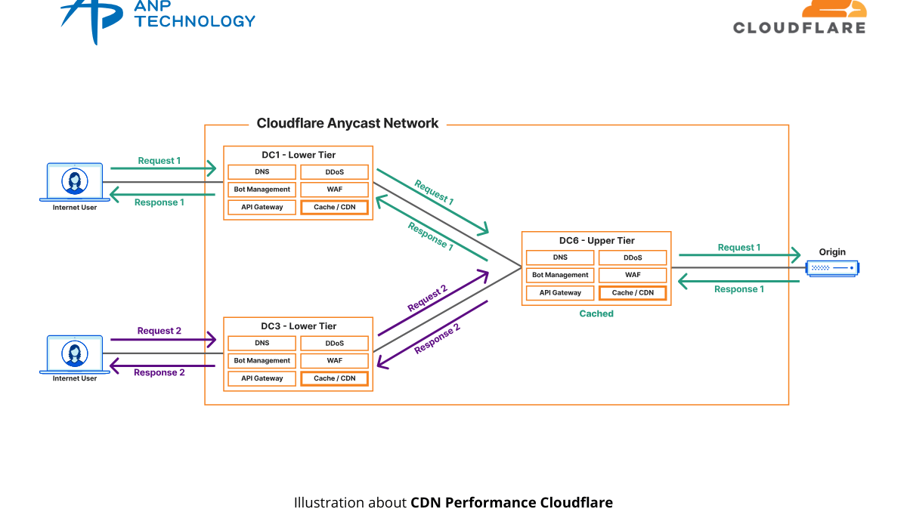
CHAPTER 01
Introduction to
Cloudflare Caching
Understanding the fundamentals of Cloudflare's CDN caching system and how it accelerates content delivery

Slide 4
FUNDAMENTALS
What is Cloudflare Caching?
How It Works
Content Types
Cloudflare stores copies of your website content on servers in 275+ data centers worldwide . When users request content, it's served from the nearest location instead of your origin server.
Static Content
Images, CSS, JavaScript, fonts — cacheable by default
Dynamic Content
HTML, JSON, API responses — not cached by default
Performance Benefits
Reduced latency by serving content geographically closer to users. Lower origin server load as cached content doesn't require origin processing.
Key Factors
Caching levels configuration
File extension matching
DDoS Protection
Query string handling
Caching provides automatic DDoS mitigation by absorbing traffic at the edge, protecting your origin server from overwhelming requests.
Origin cache-control headers
Cache rules and page rules

Slide 5
CACHING ARCHITECTURE
Caching Models: Edge vs Browser
Edge Caching
Browser Caching
Content stored on Cloudflare's global CDN servers (275+ data centers). Serves content from the nearest location to the user.
Content stored in the user's web browser. Eliminates network requests entirely for repeat visits.
Controlled by Edge Cache TTL
Controlled by Browser Cache TTL
Not visible in response headers
Visible in Cache-Control headers
Minimum: 2 hours
Default: 4 hours
Request Flow Diagram
User
Browser Cache
Edge Cache
Origin Server
Check First
Check Second
Last Resort

Slide 6
CHAPTER 02
Default Cache
Behavior
Understanding what Cloudflare caches automatically and the default time-to-live settings

Slide 7
DEFAULT BEHAVIOR
Default Cached File Extensions
Cloudflare caches these file types automatically based on extension (not MIME type)
7Z
AVI
AVIF
APK
Archive
Video
Image
Android
BIN
BMP
BZ2
CLASS
Binary
Image
Archive
Java
CSS
CSV
DOC
DOCX
Stylesheet
Data
Document
Document
DMG
EJS
EOT
EPS
macOS
Template
Font
Image
EXE
FLAC
GIF
GZ
Executable
Audio
Image
Archive
ICO
ISO
JAR
JPG
Icon
Disk Image
Java
Image
JPEG
JS
MID
MIDI
Image
JavaScript
Audio
Audio
MKV
MP3
MP4
OGG
Video
Audio
Video
Audio
OTF
PDF
PICT
PLS
Font
Document
Image
Playlist
PNG
PPT
PPTX
PS
Image
Presentation
Presentation
PostScript
RAR
SVG
SVGZ
SWF
Archive
Vector
Vector
Flash
TAR
TIF
TIFF
TTF
Archive
Image
Image
Font
WEBM
WEBP
WOFF
WOFF2
Video
Image
Font
Font
XLS
XLSX
ZIP
ZST
Spreadsheet
Spreadsheet
Archive
Archive
Not Cached by Default
HTML and JSON files are NOT cached by default. To cache these, you need to create a Cache Rule with "Cache Everything" setting.

Slide 8
DEFAULT BEHAVIOR
Default Edge Cache TTL
When no cache-control directive or expires header is present
Default TTL Values
Important Notes
All other status codes are not cached by default
200
OK
120 min
Origin headers override defaults when present
Cache Rules can customize TTL per status code
Edge TTL is not visible in response headers
206
Partial
120 min
301
Redirect
120 min
302/303
Redirect
20 min
404/410
Not Found
3 min

Slide 9
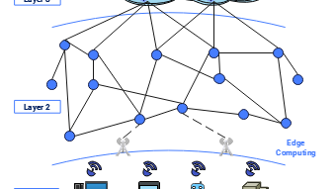
CHAPTER 03
Cache Levels &
Configuration
Controlling how Cloudflare handles query strings and browser caching settings

Slide 10
CONFIGURATION
Cache Level Options
Control how Cloudflare handles URLs with query strings
No Query String
Basic Level
Most Restrictive Caching
Only caches URLs without query strings. URLs with parameters are never cached.
✓ Cached
✗ Not Cached
example.com/image.jpg
example.com/image.jpg?size=large
Best for: Simple static sites where query strings always indicate dynamic content
Ignore Query String
Simplified Level
Unified Caching
Caches resources regardless of query strings. All variations serve the same cached content.
✓ Same Cache
✓ Same Cache
example.com/image.jpg
example.com/image.jpg?size=large
Best for: URLs with tracking parameters (UTM) that don't change content
Standard
Aggressive Level
Recommended for Most Sites
Caches URLs with query strings separately. Each unique URL gets its own cache entry.
✓ Separate Cache
✓ Separate Cache
example.com/image.jpg
example.com/image.jpg?size=large
Best for: Dynamic sites where query strings affect content (e.g., ?page=2, ?category=tech)

Slide 11
CONFIGURATION
Browser Cache TTL Settings
Control how long visitor browsers keep cached content
What is Browser Cache TTL?
Available Options
Browser Cache TTL tells the visitor's web browser how long to keep cached content before requesting a fresh copy from Cloudflare.
Respect Existing Headers
Use Cache-Control from origin server
Key Points:
Visible in Cache-Control headers sent to browser
30 Minutes - 1 Year
Default: 4 hours
Fixed time periods (various options)
Minimum: 1 second
Recommendations
Performance vs Freshness
Static assets: 1 year (versioned filenames)
+
Longer TTL = Better Performance
CSS/JS: 1 month to 1 year
Less frequent requests to Cloudflare
−
Longer TTL = Stale Content
Images: 1 month to 6 months
Users may see outdated versions
Dynamic content: Respect existing headers

Slide 12
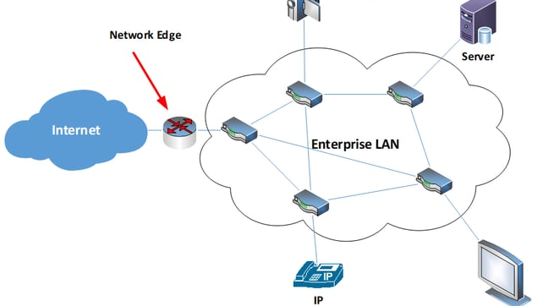
CHAPTER 04
Cache Rules
Fine-grained control over caching behavior with modern rule-based configuration

Slide 13
CACHE RULES
Understanding Cache Rules
Modern approach to fine-grained caching control
What Are Cache Rules?
Rule Creation Workflow
Cache Rules are Cloudflare's modern rule system that gives you precise control over which resources are cached and for how long, based on various matching criteria.
1
Define Match Conditions
URL patterns, file types, headers, cookies, etc.
2
Set Cache Eligibility
Key Benefits:
Eligible for cache, bypass cache, or no change
More flexible than Page Rules
Support complex expressions
3
Configure Edge TTL
How long to cache at Cloudflare edge
Better performance & scalability
4
Set Status Code TTL
Different TTLs for different HTTP responses
Expression Builder
Create rules using visual builder or expression editor:
Matching Criteria
URL path contains, equals, matches regex
// Example: Cache all assets
File extension (e.g., .jpg, .css, .js)
(http.request.uri.path contains "/assets/")
Request headers and cookies
or
Query parameters presence or values
(http.request.uri.path contains "/static/")
Hostname and SSL settings

Slide 14
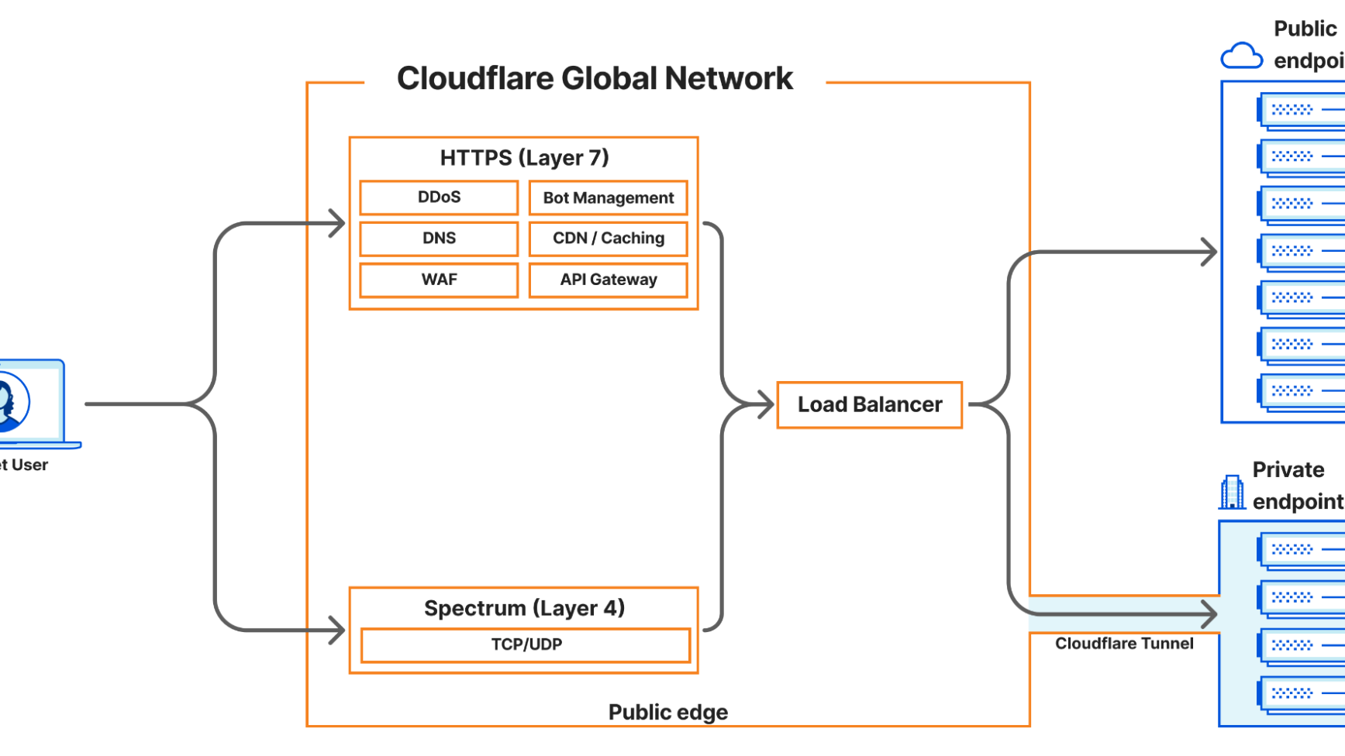
CHAPTER 06
Best Practices
Optimization strategies and recommendations for effective caching

Slide 15
OPTIMIZATION
Caching Best Practices
Strategies to maximize performance and minimize issues
1. Set Proper Cache-Control Headers
4. Monitor Cache Hit Ratios
Configure headers on your origin server to guide Cloudflare's caching decisions.
Track your cache performance using Cloudflare Analytics:
# Dynamic content (HTML pages)
Aim for 70%+ cache hit ratio
Cache-Control: max-age=0, must-revalidate, public
Identify high cache miss URLs
# Static versioned assets
Optimize cache keys for better hits
Cache-Control: public, max-age=31536000, immutable
5. Use Standard Cache Level
2. Version Your Static Assets
For dynamic sites, use Standard cache level to ensure query string variations are cached separately. Prevents serving wrong content when parameters affect output.
Use versioned filenames to enable long cache times while allowing updates.
❌ Don't:
styles.css
✓ Do:styles-v123.css or styles.a1b2c3.css
6. Test Your Configuration
Verify caching is working as expected:
Check CF-Cache-Status header
3. Use Bypass Cache on Cookie
Use browser dev tools Network tab
For dynamic/personalized content, use Bypass Cache on Cookie to skip caching when session cookies are present. Essential for e-commerce and logged-in user areas.
Test with curl: curl -I https://example.com

Slide 16
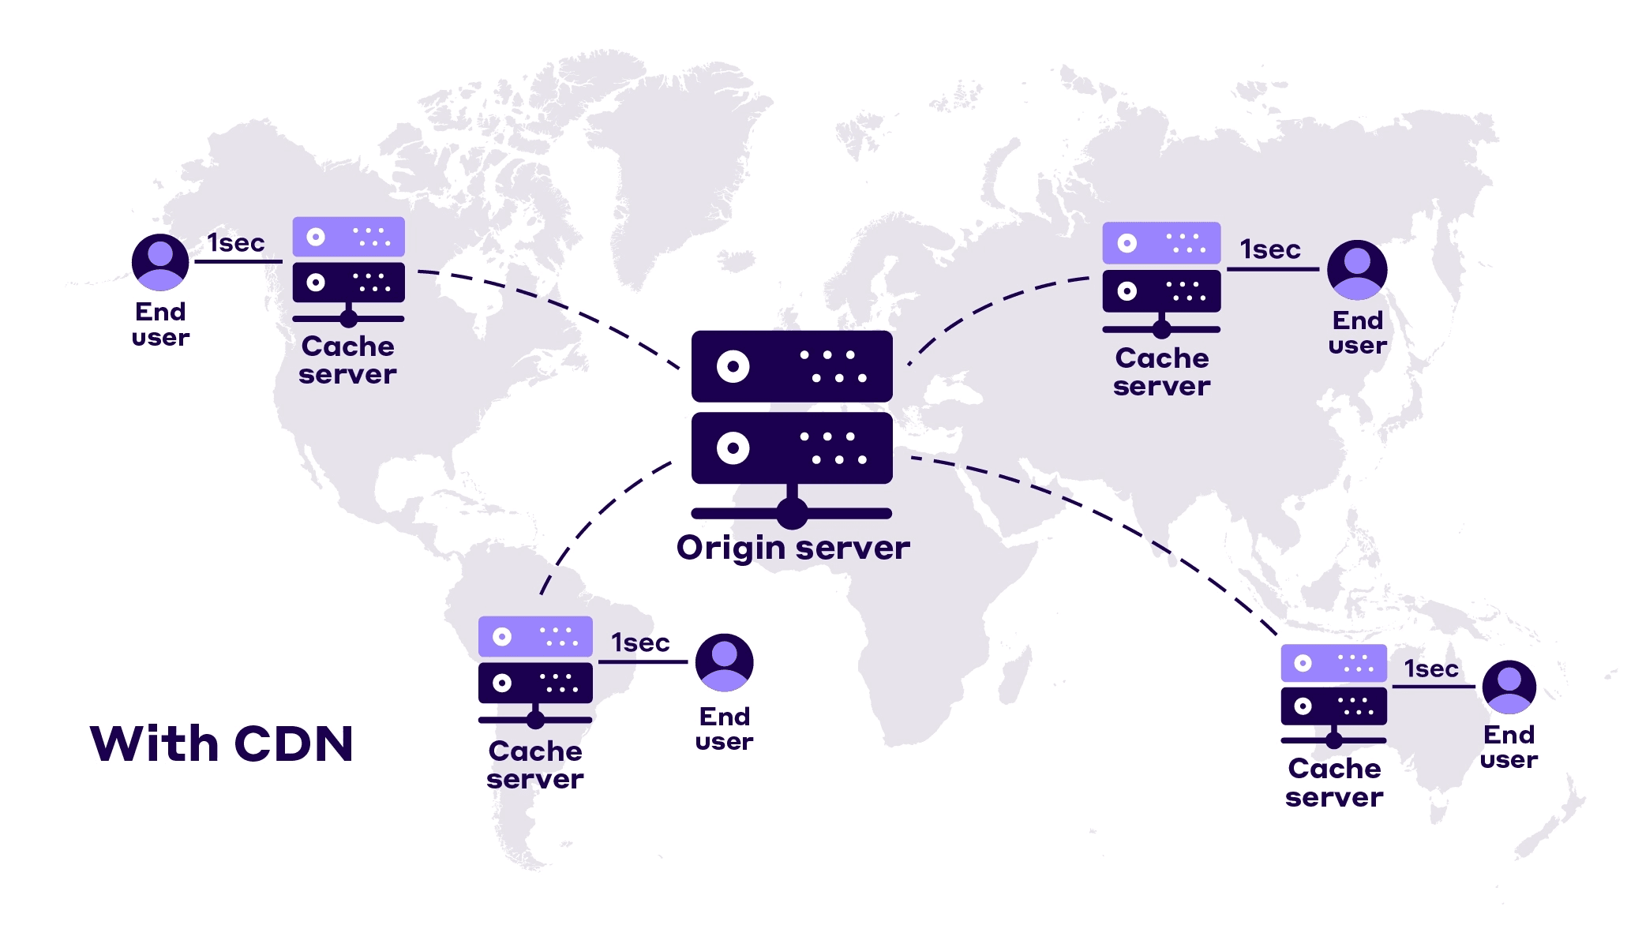
Key Takeaways
1
Cloudflare caching significantly improves performance by storing content closer to users across 275+ global data centers
2
Understand the difference between edge caching (Cloudflare servers) and browser caching (client-side) with different TTL controls
3
Use Cache Rules for fine-grained control over modern applications, with support for complex expressions and status code TTLs
4
Apply "Cache Everything" carefully with proper Edge TTL settings and consider using "Bypass Cache on Cookie" for dynamic content
5
Always set appropriate Cache-Control headers on your origin server to guide Cloudflare's caching decisions effectively
Optimize Performance • Reduce Latency • Protect Origin

